Slide 1

Introduction to Log File Analysis
By Zach Mewshaw

Slide 2

Objectives:
Understand what log files are, how they are used, and where to find them.
Understand the basics of analyzing log files in Linux command line and PowerShell.
Understand the basics of scripting in Bash and PowerShell to aid in our analysis.
Notes:
So just to give you guys a clear understanding of what exactly we’re going to be doing today, we’ll start off with an overview of log files in general and go through their uses in Windows and Linux operating systems.
We’ll then go into how we can analyze them within their respective operating systems.
And finally, I’m going to give you guys an introduction to scripting in Bash and PowerShell to help with our analysis.
So hopefully at then end of this you guys will be able to have a solid understanding of how to approach most log file analysis problems whether it be in competitions or in the real world.

Slide 3
What are log files? Why should I care?
“A log file is a file that records either events that occur in an operating system or other software runs, or messages between different users of a communication software.” (Wikipedia).
Notes:
So, what is a log file? A log file is any file that’s generated from observed information. This data can come from networks or hosts.
They are important because they are used in every job that you could get in cybersecurity (Sysadmin/Pentester/Threat analyst).
Where can they be found?
Linux - /var/log
Windows -

Slide 4
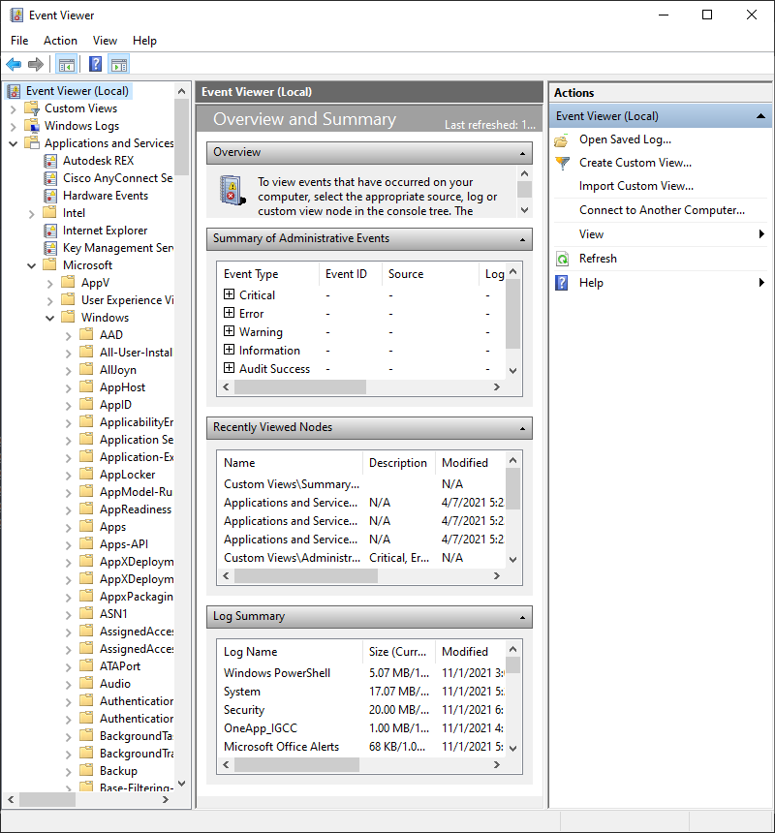
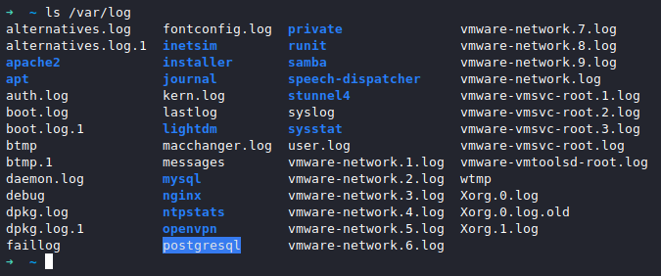
Where are they found?
Windows 10: Event Viewer
Linux: /var/log

Slide 5
Text Processing in Linux
We can analyze log files in Linux extremely fast with text processing commands.
Grep, awk, cut, sort, uniq,
We briefly looked at the use of these commands last week.

Slide 6
Examples of Linux Text Processing
Insert example

Slide 7
Tools for Analyzing Windows 10 Logs
Powershell

Slide 8
PowerShell Commands for Event Viewer
Powershell commands

Slide 9
Examples of PowerShell
Insert example

Slide 10
Scripting in Bash
What is bash, how is it used?

Slide 11
Example Bash Script
Cool Examples

Slide 12

Live Demo

Slide 13
Scripting in PowerShell
What is PowerShell, how is it used?
INSANELY IMPORTANT TO KNOW

Slide 14
Example PowerShell Script
Insert example

Slide 15
Live Demo

Slide 16
Thank you for your time
Questions?

